Slide 1


YouTian Peng
2021/12/30

Slide 2

Outline
Executive Summary
Introduction
Methodology
Results
Conclusion
Appendix

Slide 3
Executive Summary
Summary of methodologies After collecting the data, data pre-processing was implemented for further visual analysis, characterization, or for building machine learning classification models.
Summary of all results
Decision Tree is the most accurate model for prediction among all. Base on final decision tree model which demonstrates a final chance of a successful landing of Falcon 9 about 73%

Slide 4
Introduction
Project background and context
SpaceX advertises Falcon 9 rocket launches on its website with a cost of 62 million dollars; other providers cost upward of 165 million dollars each, much of the savings is because SpaceX can reuse the first stage.
Problems you want to find answers
If the Falcon 9 first stage will land successfully. if we can determine if the first stage will land, we can determine the cost of a launch. This information can be used if an alternate company wants to bid against SpaceX for a rocket launch.

Slide 5


Slide 6
Methodology
Executive Summary
Data collection methodology:
Obtain Data through API
Obtain Data through WebScaping
Perform data wrangling
Dealing with Missing Values
Convert Categorical Data for Featuring
Perform exploratory data analysis (EDA) using visualization and SQL
Perform interactive visual analytics using Folium and Plotly Dash
Perform predictive analysis using classification models
Logistic Regression, SVM, Decision Tree, KNN

Slide 7
Data Collection
There are two different methods for data collection:
Web API
Web Scraping

Slide 8
Data Collection – SpaceX API
Firstly I request and parse data using the GET request, then JSON file was decoded. After that, dataset was extracted for filtering "Falcon 9" launches data.
GitHub URL:
https://github.com/rorschachwilpeng/cousera_IBM_ds/blob/main/ds_capstone/Week1%20-%3E%20Introduction/Collecting%20the%20Data/Data%20Collection%20with%20API.ipynb
API
Decode Json File
Construct Dataset

Slide 9
Data Collection - Scraping
Firstly, I requested the Falcon 9 launch wiki page from its URL. Then all columns/variables names from HTML table header were extracted. After that, only useful headers were selected for creating dataframe.
GitHub URL:
https://github.com/rorschachwilpeng/cousera_IBM_ds/blob/main/ds_capstone/Week1%20-%3E%20Introduction/Collecting%20the%20Data/Data%20Collection%20with%20Web%20Scraping.ipynb
Request the Falcon 9 Launch Wiki page from its URL
Extract all columns names from HTML table header
Create a dataframe by parsing the launch HTML tables

Slide 10
Data Wrangling
Two main tasks of the Data Wrangling:
Dealing with missing values
Two column "PayloadMass", "LandingPad" exist missing values, only "PayloadMass" missing values were replaced with mean value of rest in this column. Data in the "LandingPad" retain NaN due to the lack of utilization of this data.
Convert the "outcome"(landing outcome) into binary results.
Data in outcome were converted into 1/0. "1" means landing successfully, where "0" means landing unsuccessfully.
GitHub URL:
https://github.com/rorschachwilpeng/cousera_IBM_ds/blob/main/ds_capstone/Week1%20-%3E%20Introduction/Data%20Wrangling/Data%20Collection%20with%20Data%20Wrangling.ipynb

Slide 11
EDA with Data Visualization
Three types of chars were drew: "Scatter Point Chart", "Bar Chart", "Line Chart"
Scatter Point Chart: For observing each pair of attributes relative relationship with landing result.
Bar Chart: For observing the relationship between landing success rate and orbit types.
Line Chart: For observing the relationship between landing success rate and years.
GitHub URL: https://github.com/rorschachwilpeng/cousera_IBM_ds/blob/main/ds_capstone/Week2%20-%3E%20EDA%20with%20SQL/Exploratory%20Analysis%20Using%20Pandas%20and%20Matplotlib/jupyter-labs-eda-dataviz.ipynb

Slide 12
GitHub URL:
https://github.com/rorschachwilpeng/cousera_IBM_ds/blob/main/ds_capstone/Week2%20-%3E%20EDA%20with%20SQL/Exploratory%20Analysis%20Using%20SQL/EDA%20with%20SQL.ipynb
EDA with SQL
Display the names of the unique launch sites in the space mission
%sql select distinct(launch_site) from SPACEXTBL;
Display 5 records where launch sites begin with the string 'CCA'
%sql select * from SPACEXTBL where launch_site like 'CCA%' limit 5;
Display the total payload mass carried by boosters launched by NASA (CRS)
%sql select sum(payload_mass__kg_) from SPACEXTBL where customer = 'NASA (CRS)';
Display average payload mass carried by booster version F9 v1.1
%sql select avg(payload_mass__kg_) from SPACEXTBL where booster_version like 'F9 v1.1%';
List the total number of successful and failure mission outcomes
%sql select mission_outcome,count(*) as Counter from SPACEXTBL group by mission_outcome;
List the names of the booster_versions which have carried the maximum payload mass. Use a subquery
%sql select distinct(booster_version) from SPACEXTBL where payload_mass__kg_ = (select max(payload_mass__kg_) from SPACEXTBL);
List the failed landing_outcomes in drone ship, their booster versions, and launch site names for in year 2015
%sql select landing__outcome,booster_version,launch_site,date from SPACEXTBL where Date like '2015%' and landing__outcome = 'Failure (drone ship)';
Rank the count of landing outcomes (such as Failure (drone ship) or Success (ground pad)) between the date 2010-06-04 and 2017-03-20, in descending order
%sql select landing__outcome,count(landing__outcome) as count from SPACEXTBL where DATE BETWEEN '2010-06-04' and '2017-03-20' GROUP BY landing__outcome ORDER BY count(landing__outcome) DESC;
List the date when the first successful landing outcome in ground pad was acheived.
%sql select min(DATE) from SPACEXTBL where landing__outcome = 'Success (ground pad)';
List the names of the boosters which have success in drone ship and have payload mass greater than 4000 but less than 6000
%sql select distinct(booster_version) from SPACEXTBL where landing__outcome = 'Success (drone ship)' AND payload_mass__kg_ > 4000 AND payload_mass__kg_ < 6000;

Slide 13
Build an Interactive Map with Folium
There are three objected be added to Map:
Mark all launch sites on a map
Mark the success/failed launches for each site on the map
Calculate the distances between a launch site to its proximities
GitHub URL:
https://github.com/rorschachwilpeng/cousera_IBM_ds/blob/main/ds_capstone/Week3%20-%3E%20Interactive%20Visual%20Analytics%20and%20Dashboard/lab_jupyter_launch_site_location.ipynb

Slide 14
Predictive Analysis (Classification)
Four main steps for performing best model:
Split train and test datasets;
Trained Models(Logistic Regression, SVM, Decision Tree, KNN)
Find best parameters for each model with GridSearch CV
Select best model base on prediction accuracy
Flowcharts:
GitHub URL:
https://github.com/rorschachwilpeng/cousera_IBM_ds/blob/main/ds_capstone/Week4%20-%3E%20Predictive%20Analysis%20(Classfication)/SpaceX_Machine%20Learning%20Prediction_Part_5.ipynb
Split dataset
Training Models
Find best parameters
Select best model

Slide 15
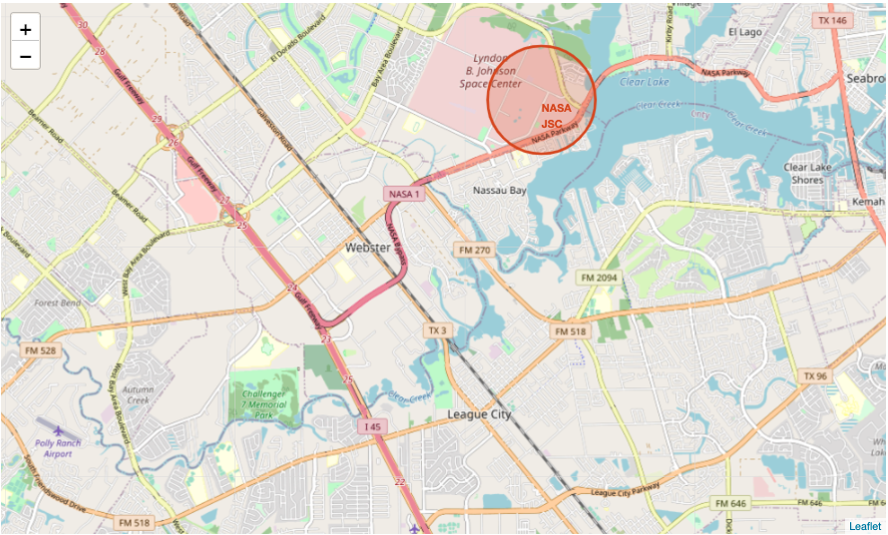
Results
Exploratory data analysis results
At the VAFB-SLC launch site there are no rockets launched for heavy payload mass(greater than 10000).
"ES-L1", "GEO", "HEO", "SSO" orbit type have highest success rate(100%)
With heavy payloads the successful landing or positive landing rate are more for Polar, LEO and ISS
…
Interactive analytics demo in screenshots
Predictive analysis results
Desicision Tree is best model;
The final prediction for landing success rate is about 73%

Slide 16


Slide 17
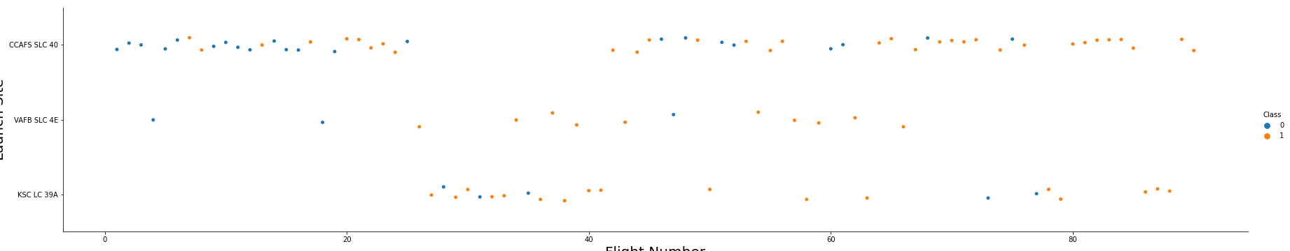
Flight Number vs. Launch Site
Scatter plot of Flight Number vs. Launch Site
Explanation for the plot:
For "CCAFS SLC 40": The success rate rise with the increasement of the flight numbers;
For "VAFB SLC 4E": The success rate rise with the increasement of the flight numbers;
For "KSC LC 39A": There is no instance when flight number is smaller than 28.

Slide 18
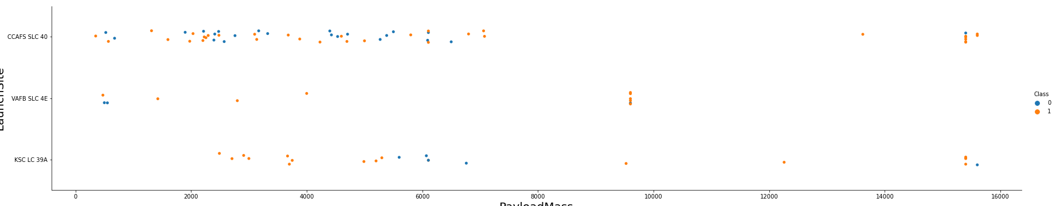
Payload vs. Launch Site
Show a scatter plot of Payload vs. Launch Site
Plot Explanations:
The VAFB-SLC launchsite there are no rockets launched for heavypayload mass(greater than 10000).

Slide 19
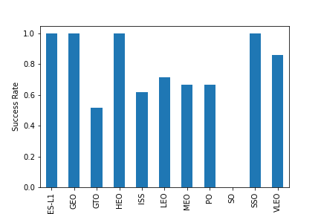
Success Rate vs. Orbit Type
Show a bar chart for the success rate of each orbit type
Plot explanations: Orbit type of "ES-L1", ''GEO", "HEO", "SSO" have highest success rate.

Slide 20
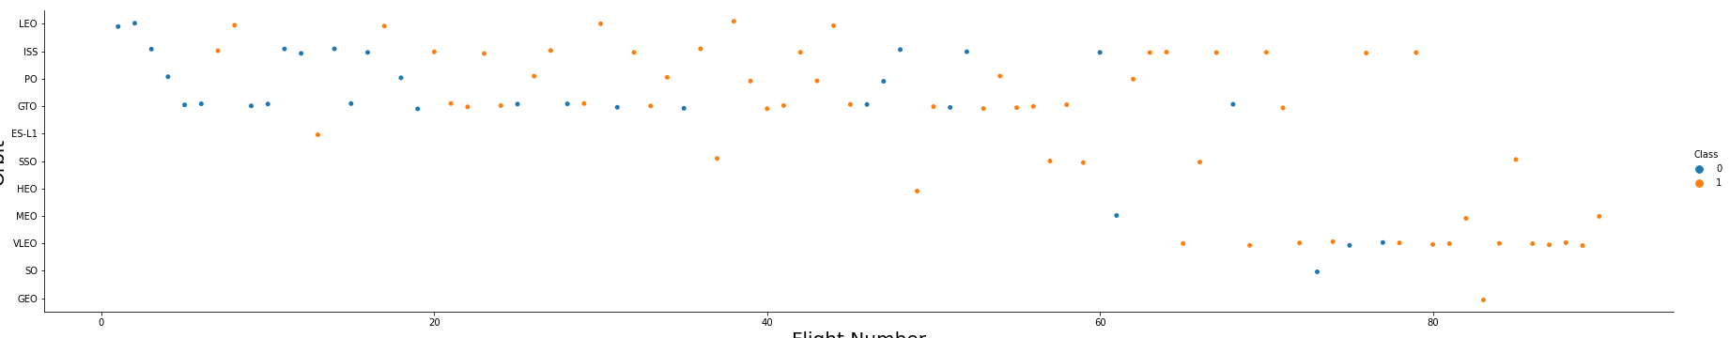
Flight Number vs. Orbit Type
Show a scatter point of Flight number vs. Orbit type
Plot Explanations: You should see that in the LEO orbit the Success appears related to the number of flights; on the other hand, there seems to be no relationship between flight number when in GTO orbit.

Slide 21
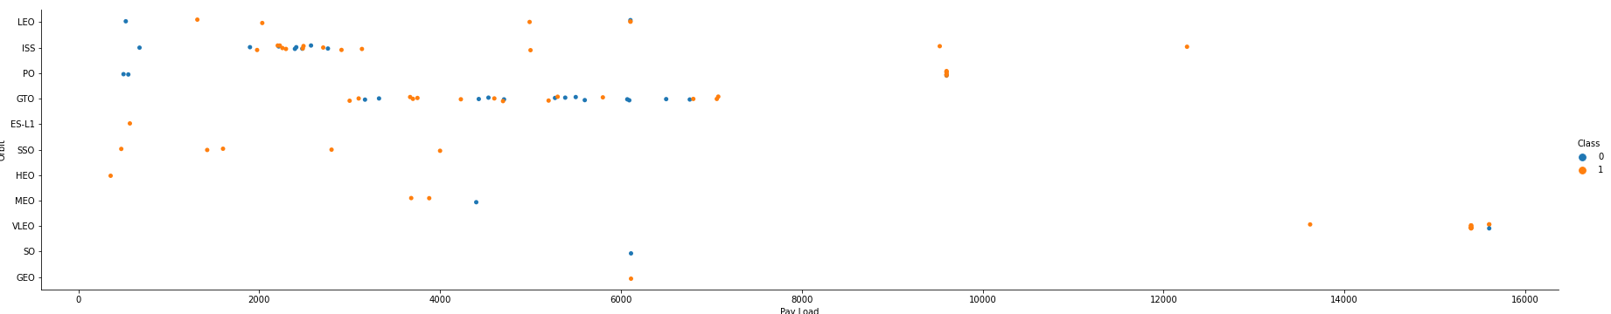
Payload vs. Orbit Type
Plot Explaination: With heavy payloads the successful landing or positive landing rate are more for Polar, LEO and ISS. However for GTO we cannot distinguish this well as both positive landing rate and negative landing(unsuccessful mission) are both there here.

Slide 22
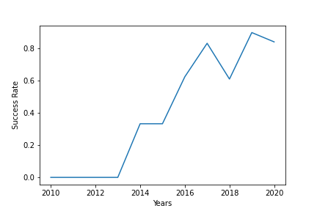
Launch Success Yearly Trend
Plot Explaination: You can observe that the sucess rate since 2013 kept increasing till 2020

Slide 23
All Launch Site Names
Find the names of the unique launch sites
Present your query result with a short explanation here
Query Result: %sql select distinct(launch_site) from SPACEXTBL;
Explanation: ...

Slide 24
Launch Site Names Begin with 'CCA'
Find 5 records where launch sites begin with `CCA`
Present your query result with a short explanation here
Query Result: %sql select * from SPACEXTBL where launch_site like 'CCA%' limit 5;
Explanation: ...

Slide 25
Total Payload Mass
Calculate the total payload carried by boosters from NASA
Present your query result with a short explanation here
Query Result: %sql select sum(payload_mass__kg_) from SPACEXTBL where customer = 'NASA (CRS)';
Explanation: Calulate the total payload with "sum()" function then select boosters from NASA base on condition "where customer = 'NASA(CRS)' ".

Slide 26
Average Payload Mass by F9 v1.1
Calculate the average payload mass carried by booster version F9 v1.1
Present your query result with a short explanation here
Query Result: %sql select avg(payload_mass__kg_) from SPACEXTBL where booster_version like 'F9 v1.1%';
Explanation: Reach bosster version with fuzzy searches.

Slide 27
First Successful Ground Landing Date
Find the dates of the first successful landing outcome on ground pad
Present your query result with a short explanation here
Query Result: %sql select min(DATE) from SPACEXTBL where landing__outcome = 'Success (ground pad)';
Explanation: ...

Slide 28
Successful Drone Ship Landing with Payload between 4000 and 6000
List the names of boosters which have successfully landed on drone ship and had payload mass greater than 4000 but less than 6000
Present your query result with a short explanation here
Query Result: %sql select distinct(booster_version) from SPACEXTBL where landing__outcome = 'Success (drone ship)' AND payload_mass__kg_ > 4000 AND payload_mass__kg_ < 6000;
Explanation: ...

Slide 29
Total Number of Successful and Failure Mission Outcomes
Calculate the total number of successful and failure mission outcomes
Present your query result with a short explanation here
Query Result: %sql select mission_outcome,count(*) as Counter from SPACEXTBL group by mission_outcome;
Explanation: ...

Slide 30
Boosters Carried Maximum Payload
List the names of the booster which have carried the maximum payload mass
Present your query result with a short explanation here
Query Result: %sql select distinct(booster_version) from SPACEXTBL where payload_mass__kg_ = (select max(payload_mass__kg_) from SPACEXTBL);
Explanation: ...

Slide 31
2015 Launch Records
List the failed landing_outcomes in drone ship, their booster versions, and launch site names for in year 2015
Present your query result with a short explanation here
Query Result: %sql select landing__outcome,booster_version,launch_site,date from SPACEXTBL where Date like '2015%' and landing__outcome = 'Failure (drone ship)';
Explanation: ...

Slide 32
Rank Landing Outcomes Between 2010-06-04 and 2017-03-20
Rank the count of landing outcomes (such as Failure (drone ship) or Success (ground pad)) between the date 2010-06-04 and 2017-03-20, in descending order
Present your query result with a short explanation here
Query Result: %sql select landing__outcome,count(landing__outcome) as count from SPACEXTBL where DATE BETWEEN '2010-06-04' and '2017-03-20' GROUP BY landing__outcome ORDER BY count(landing__outcome) DESC;
%sql SELECT * FROM SPACEXTBL where DAYNAME(DATE)='Friday' LIMIT 5 ;
Explanation: ...

Slide 33


Slide 34
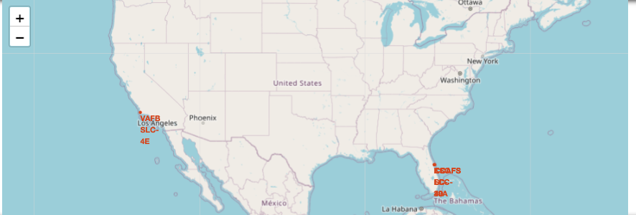
Mark all launch site on a map
All four launch sites including "CCAFS LC-40", "CCAFS SLC-40", "KSC LC-39A", "VAFB SLC-4E" were marked on the map base on their coordinates.

Slide 35
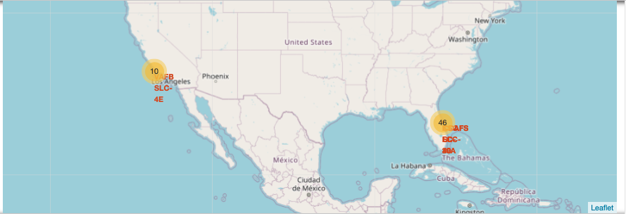
Mark the success/failed launches for each site on the map
"KSC LC 39-A" have highest success rate
"CCAFS SLC-40" have highest failed rate

Slide 36
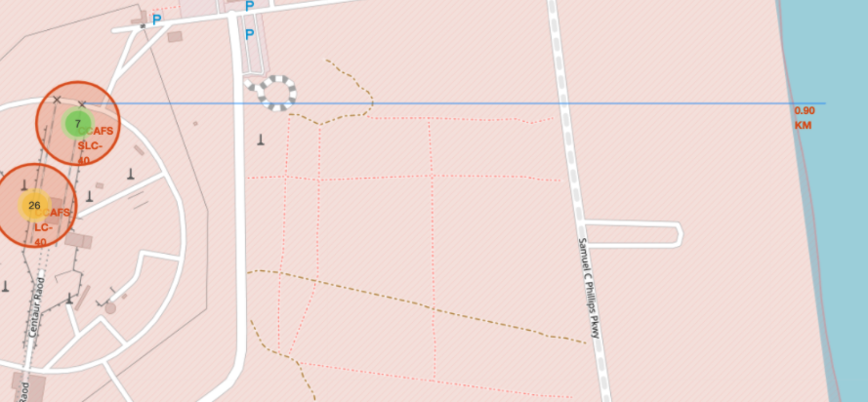
TASK 3: Calculate the distances between a launch site to its proximities
"CCAFS LC-40", "CCAFS SLC-40" are close to the "Centaur Road" and costline;
"KSC LC-39A" is close to the "Merrat Island National Wildlife Refuge";
"VAFB SLC-4E" is close to the "Dix Road".

Slide 37


Slide 38
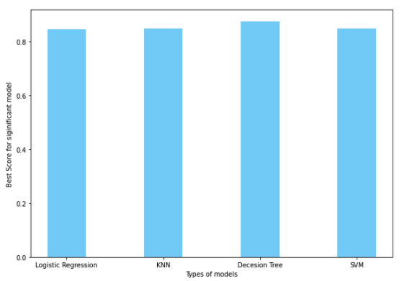
Classification Accuracy
Decision Tree have highest clasification accuracy.

Slide 39
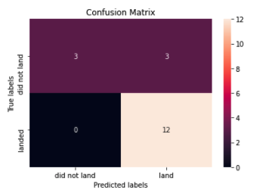
Confusion Matrix
Base on the confusion matrix, all "landed" label are predicted correctly. Whears, for "did not land", half of label are predicted correctly.

Slide 40
Conclusions
EDA: Among all orbit type, "ES-L1", "GEO", "HEO", "SSO" have high success rate
EDA: The success rate since 2013 kept increasing till 2020
EDA: The attributes of processed datasets including: 'FlightNumber', 'PayloadMass', 'Orbit', 'LaunchSite', 'Flights', 'GridFins', 'Reused', 'Legs', 'LandingPad', 'Block', 'ReusedCount', 'Serial';
Classfication: Decision Tree is best model with highest classfication accuracy.

Slide 41


